Slide 1
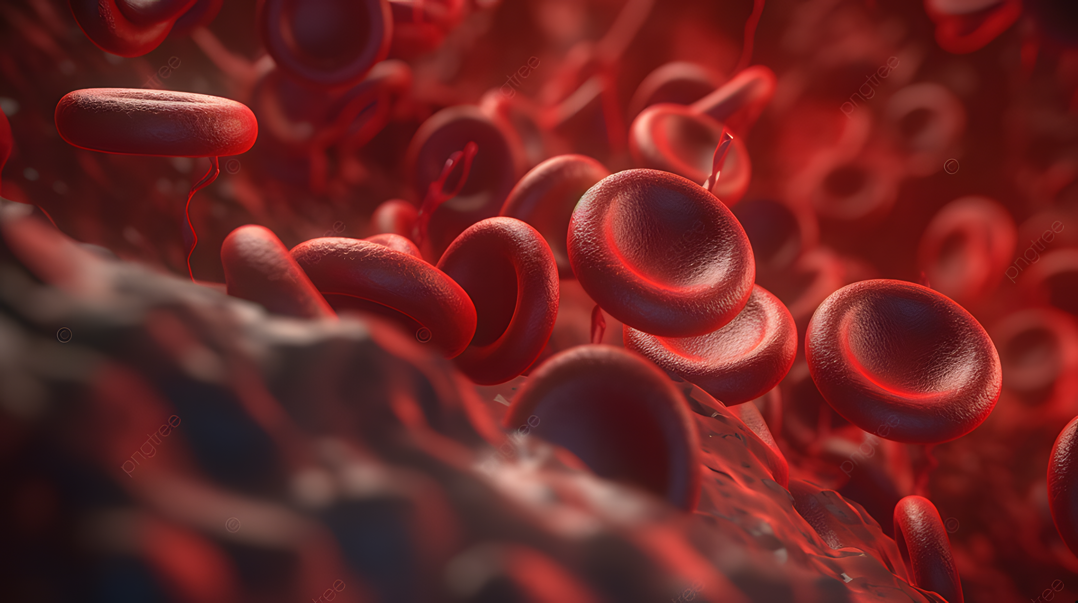
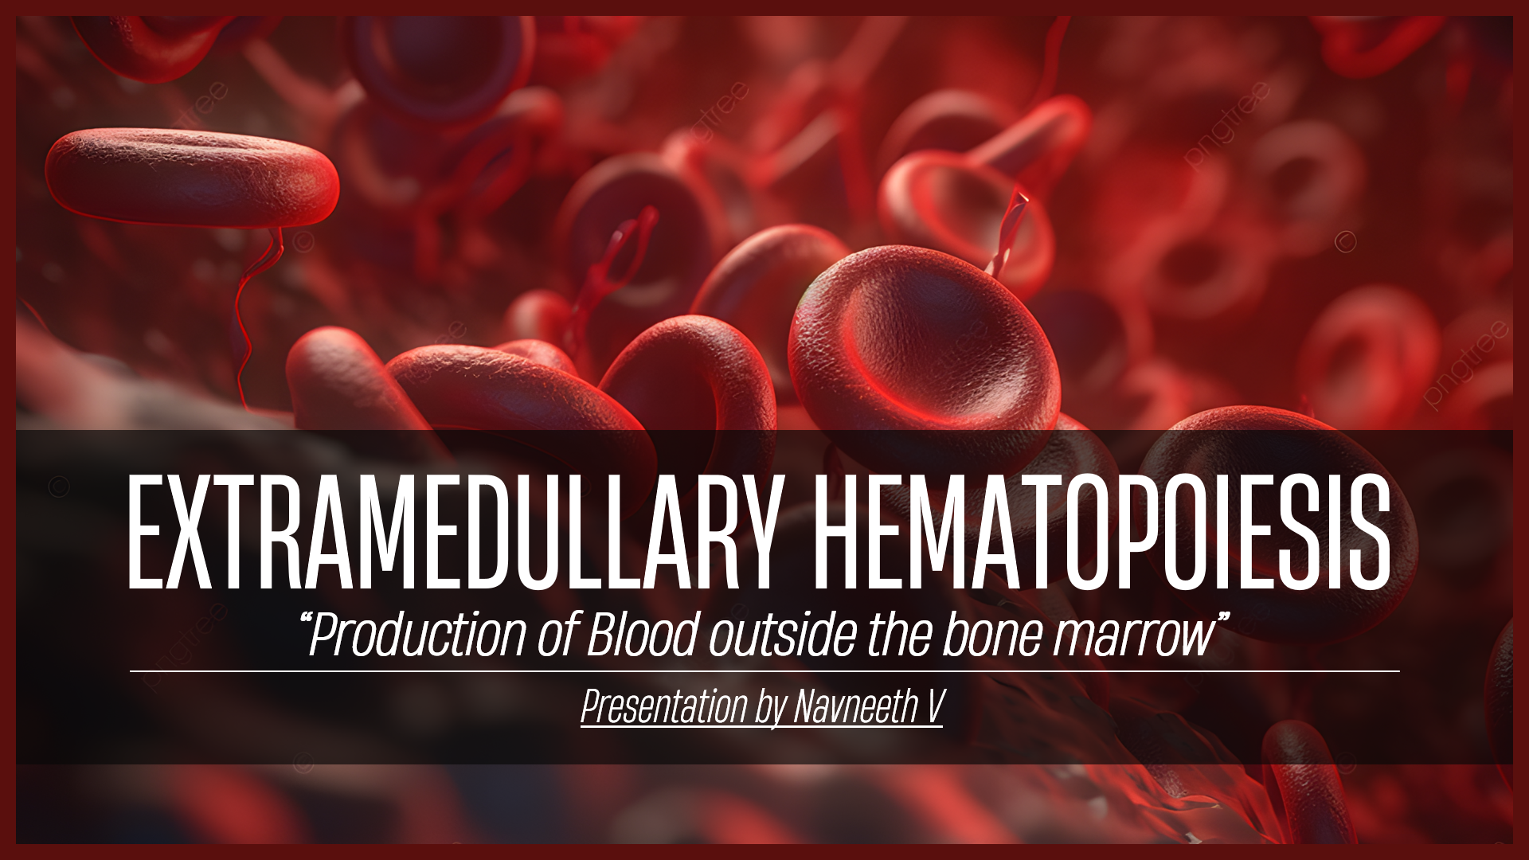
EXTRAMEDULLARY HEMATOPOIESIS
“Production of Blood outside the bone marrow”
Presentation by Navneeth V

Slide 2
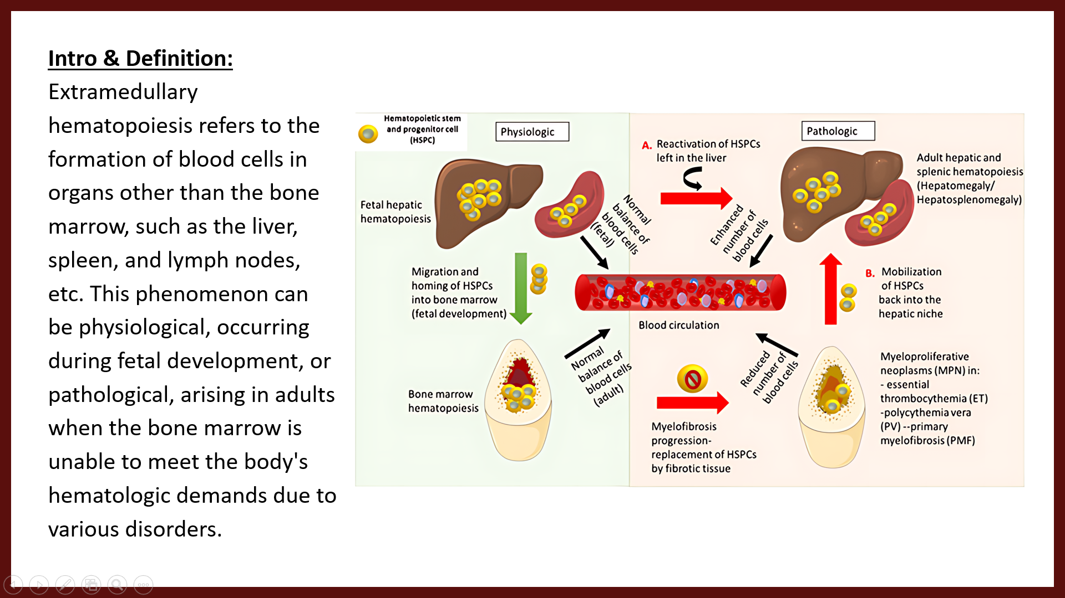
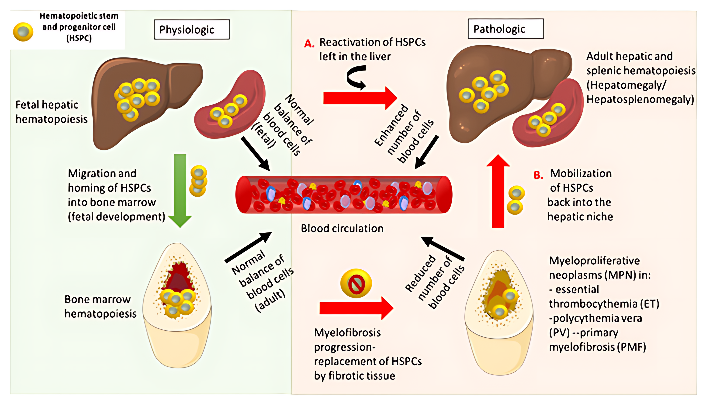
Intro & Definition: Extramedullary hematopoiesis refers to the formation of blood cells in organs other than the bone marrow, such as the liver, spleen, and lymph nodes, etc. This phenomenon can be physiological, occurring during fetal development, or pathological, arising in adults when the bone marrow is unable to meet the body's hematologic demands due to various disorders.

Slide 3
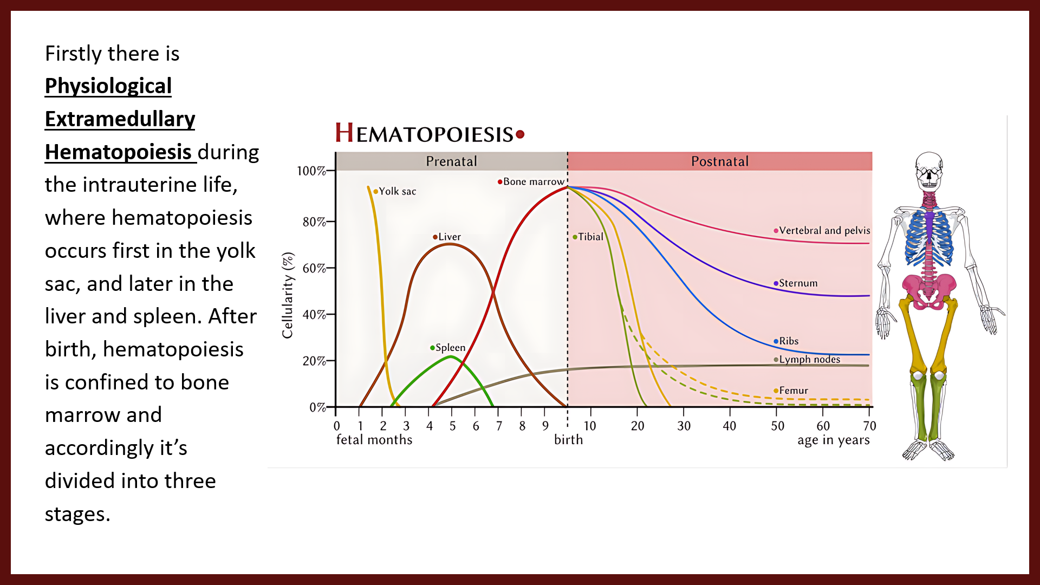
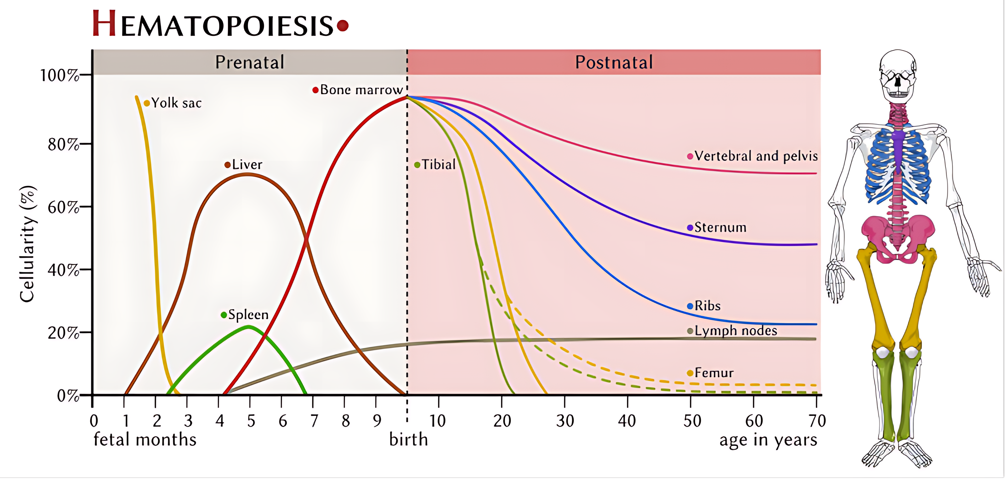
Firstly there is Physiological Extramedullary Hematopoiesis during the intrauterine life, where hematopoiesis occurs first in the yolk sac, and later in the liver and spleen. After birth, hematopoiesis is confined to bone marrow and accordingly it’s divided into three stages.

Slide 4
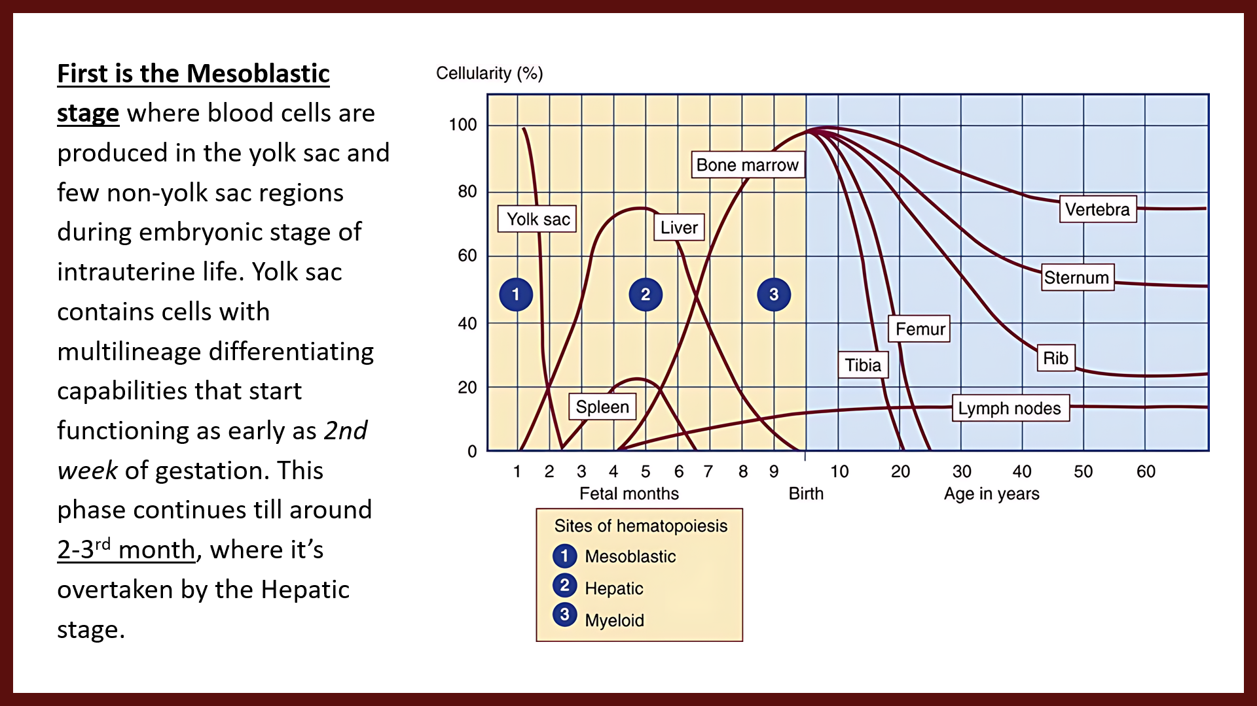
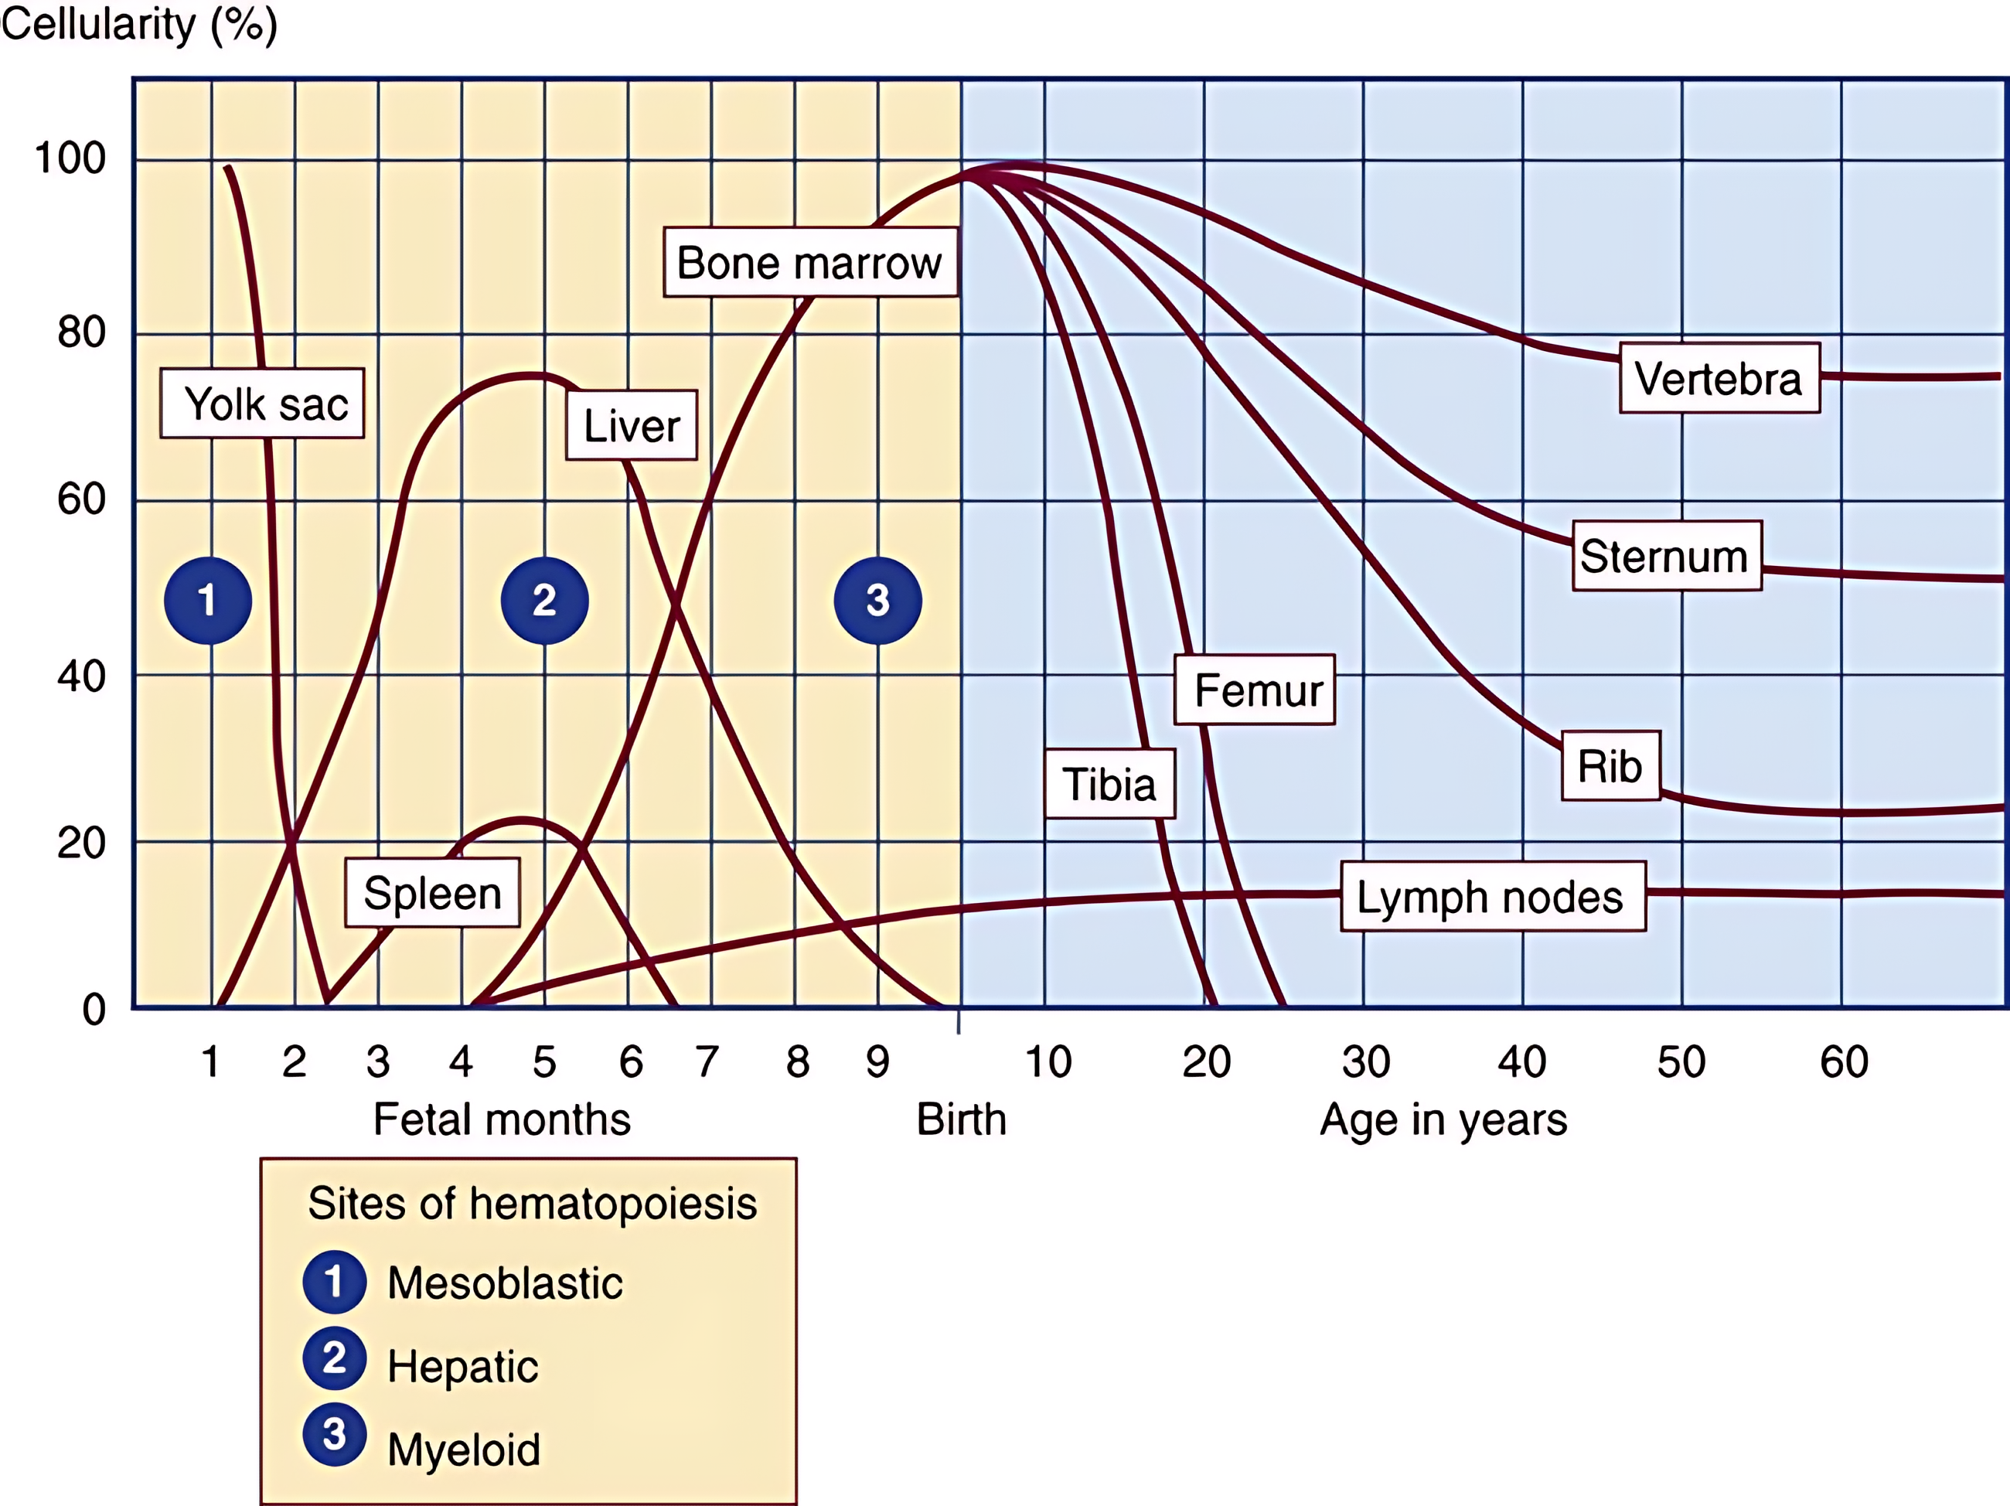
First is the Mesoblastic stage where blood cells are produced in the yolk sac and few non-yolk sac regions during embryonic stage of intrauterine life. Yolk sac contains cells with multilineage differentiating capabilities that start functioning as early as 2nd week of gestation. This phase continues till around 2-3rd month, where it’s overtaken by the Hepatic stage.

Slide 5
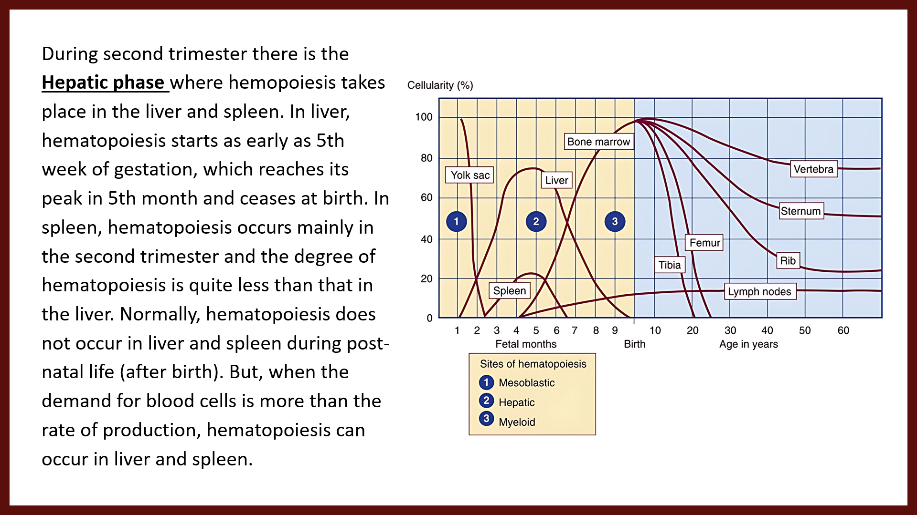
During second trimester there is the Hepatic phase where hemopoiesis takes place in the liver and spleen. In liver, hematopoiesis starts as early as 5th week of gestation, which reaches its peak in 5th month and ceases at birth. In spleen, hematopoiesis occurs mainly in the second trimester and the degree of hematopoiesis is quite less than that in the liver. Normally, hematopoiesis does not occur in liver and spleen during post-natal life (after birth). But, when the demand for blood cells is more than the rate of production, hematopoiesis can occur in liver and spleen.

Slide 6
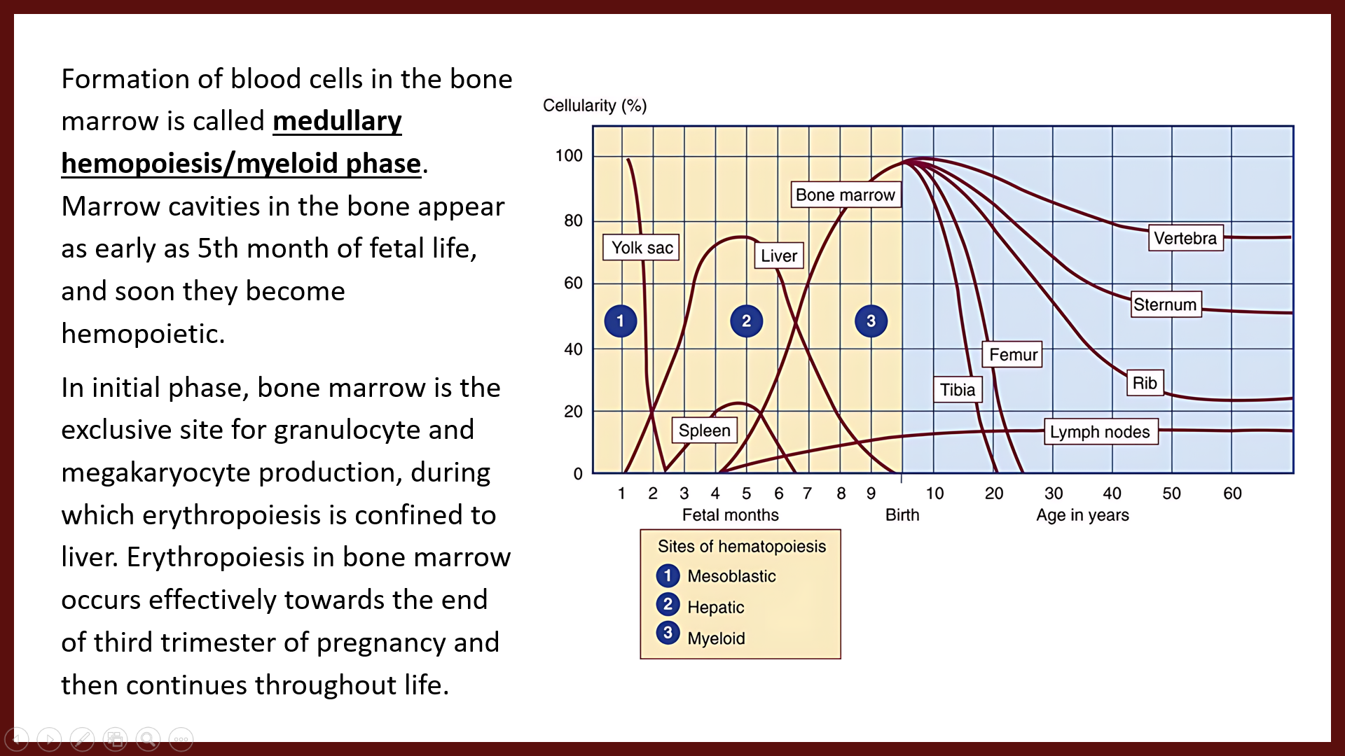
Formation of blood cells in the bone marrow is called medullary hemopoiesis/myeloid phase. Marrow cavities in the bone appear as early as 5th month of fetal life, and soon they become hemopoietic.
In initial phase, bone marrow is the exclusive site for granulocyte and megakaryocyte production, during which erythropoiesis is confined to liver. Erythropoiesis in bone marrow occurs effectively towards the end of third trimester of pregnancy and then continues throughout life.

Slide 7
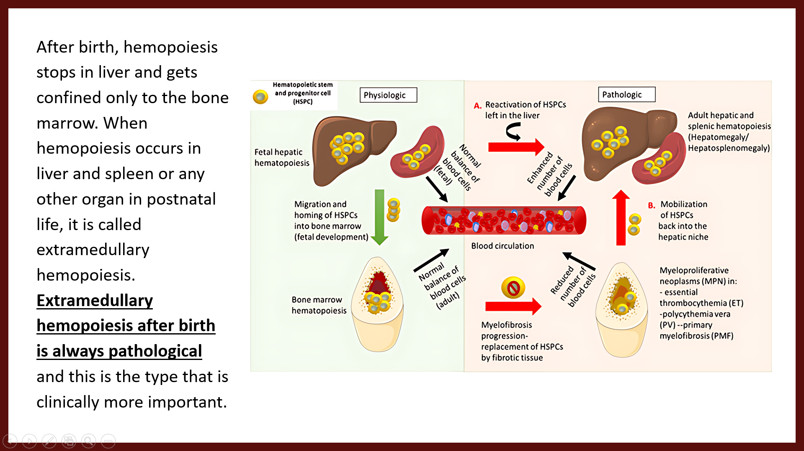
After birth, hemopoiesis stops in liver and gets confined only to the bone marrow. When hemopoiesis occurs in liver and spleen or any other organ in postnatal life, it is called extramedullary hemopoiesis. Extramedullary hemopoiesis after birth is always pathological and this is the type that is clinically more important.

Slide 8
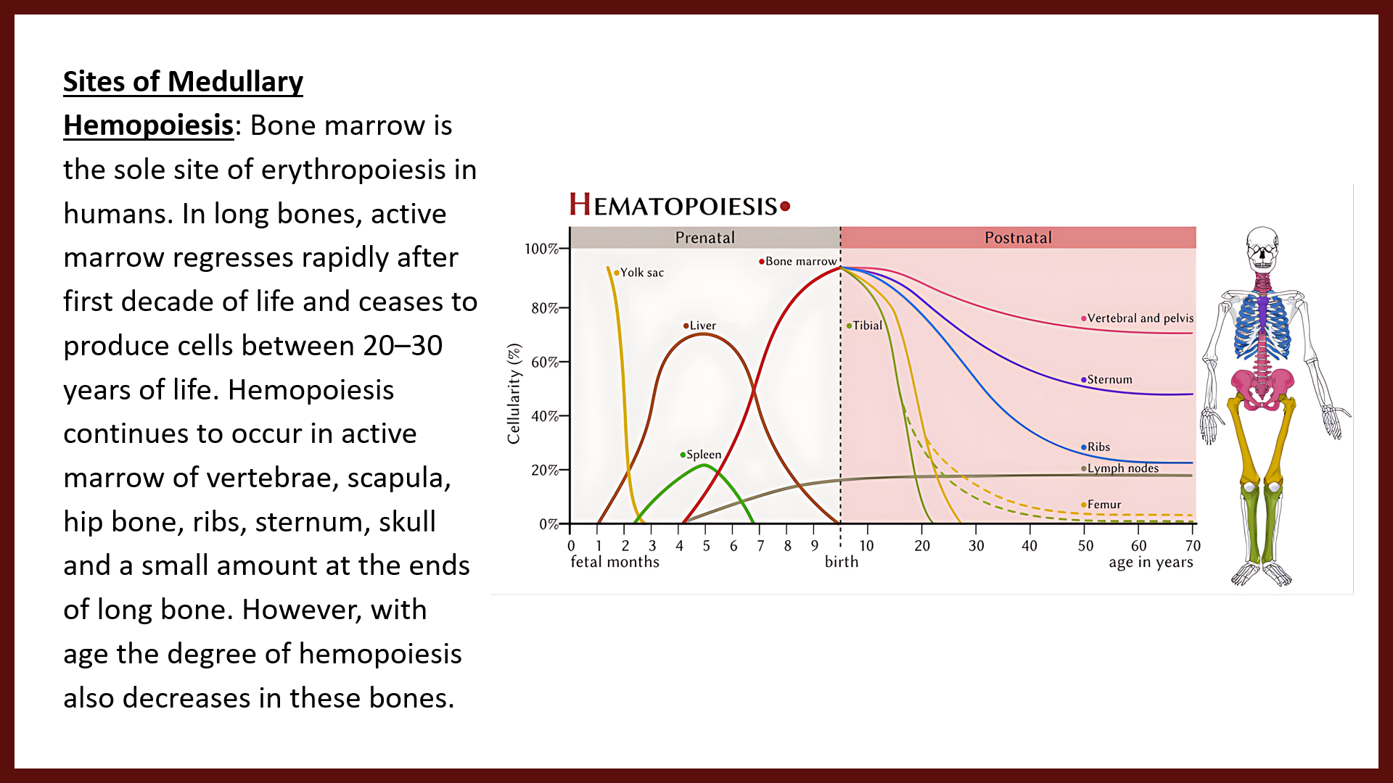
Sites of Medullary Hemopoiesis: Bone marrow is the sole site of erythropoiesis in humans. In long bones, active marrow regresses rapidly after first decade of life and ceases to produce cells between 20–30 years of life. Hemopoiesis continues to occur in active marrow of vertebrae, scapula, hip bone, ribs, sternum, skull and a small amount at the ends of long bone. However, with age the degree of hemopoiesis also decreases in these bones.

Slide 9
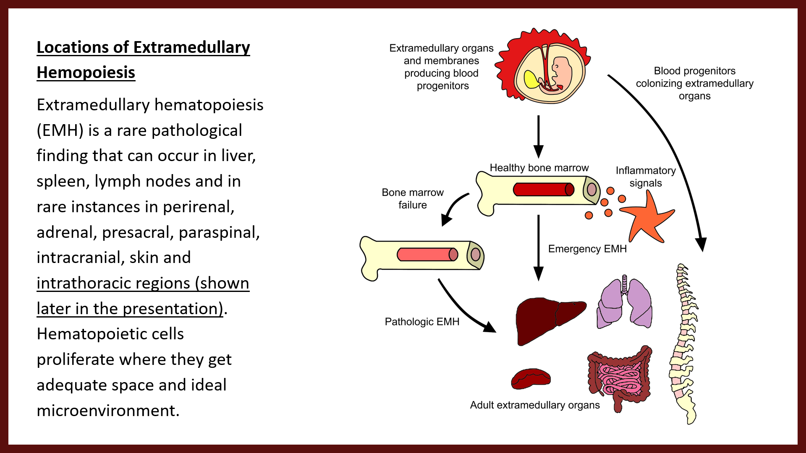
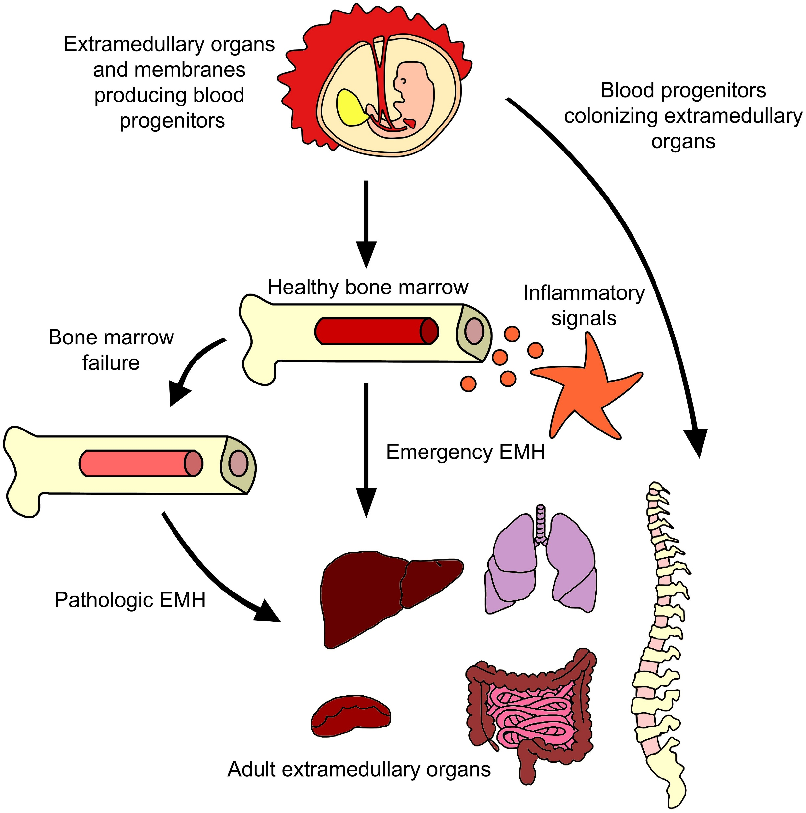
Locations of Extramedullary Hemopoiesis
Extramedullary hematopoiesis (EMH) is a rare pathological finding that can occur in liver, spleen, lymph nodes and in rare instances in perirenal, adrenal, presacral, paraspinal, intracranial, skin and intrathoracic regions (shown later in the presentation). Hematopoietic cells proliferate where they get adequate space and ideal microenvironment.

Slide 10
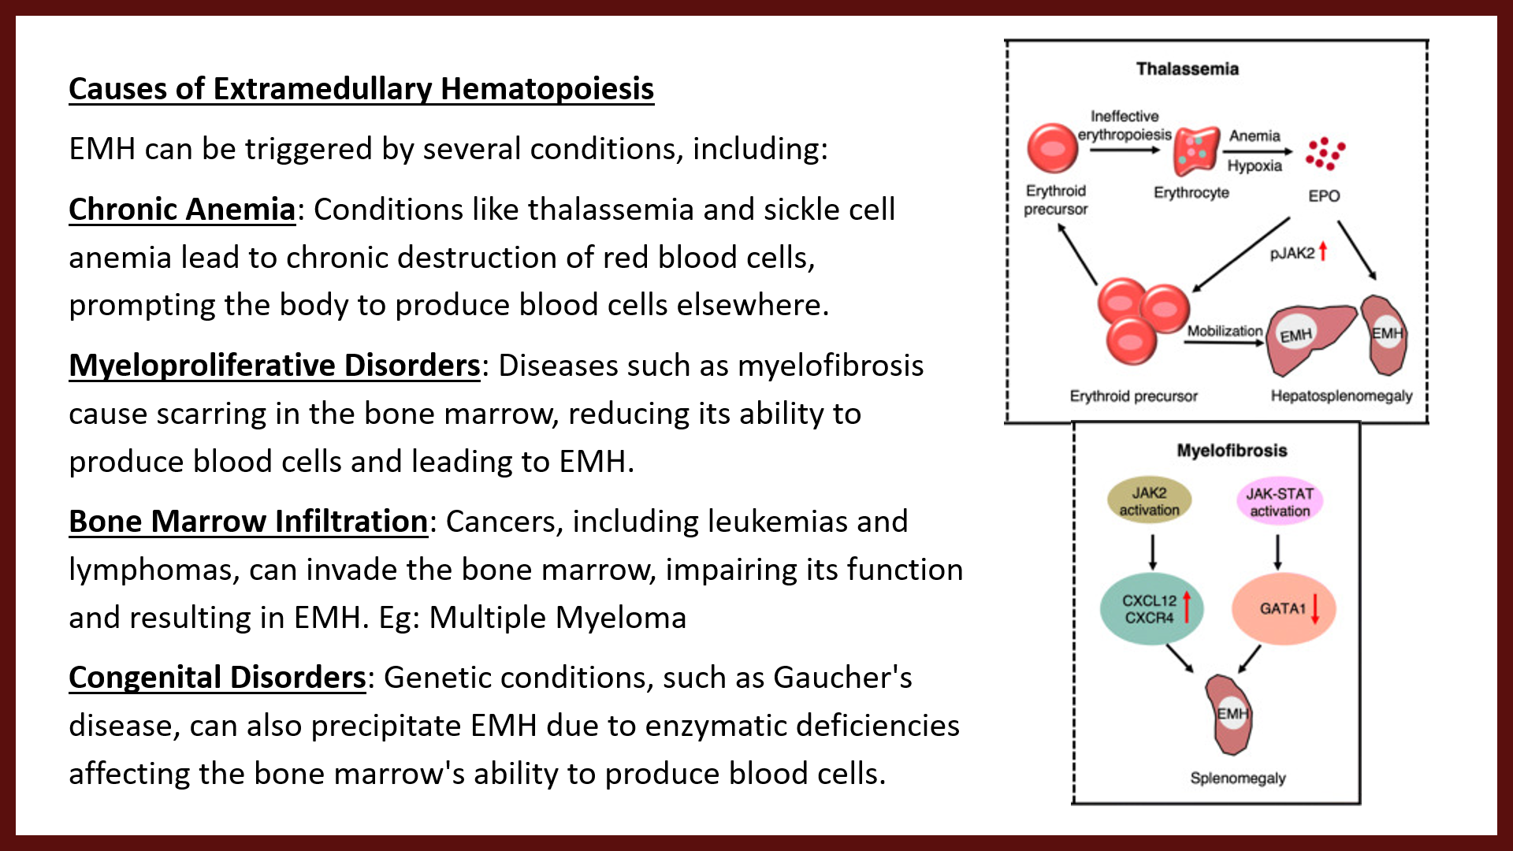
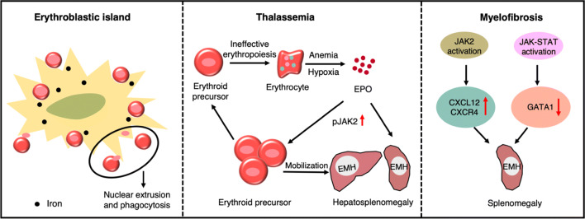
Causes of Extramedullary Hematopoiesis
EMH can be triggered by several conditions, including:
Chronic Anemia: Conditions like thalassemia and sickle cell anemia lead to chronic destruction of red blood cells, prompting the body to produce blood cells elsewhere.
Myeloproliferative Disorders: Diseases such as myelofibrosis cause scarring in the bone marrow, reducing its ability to produce blood cells and leading to EMH.
Bone Marrow Infiltration: Cancers, including leukemias and lymphomas, can invade the bone marrow, impairing its function and resulting in EMH. Eg: Multiple Myeloma
Congenital Disorders: Genetic conditions, such as Gaucher's disease, can also precipitate EMH due to enzymatic deficiencies affecting the bone marrow's ability to produce blood cells.

Slide 11
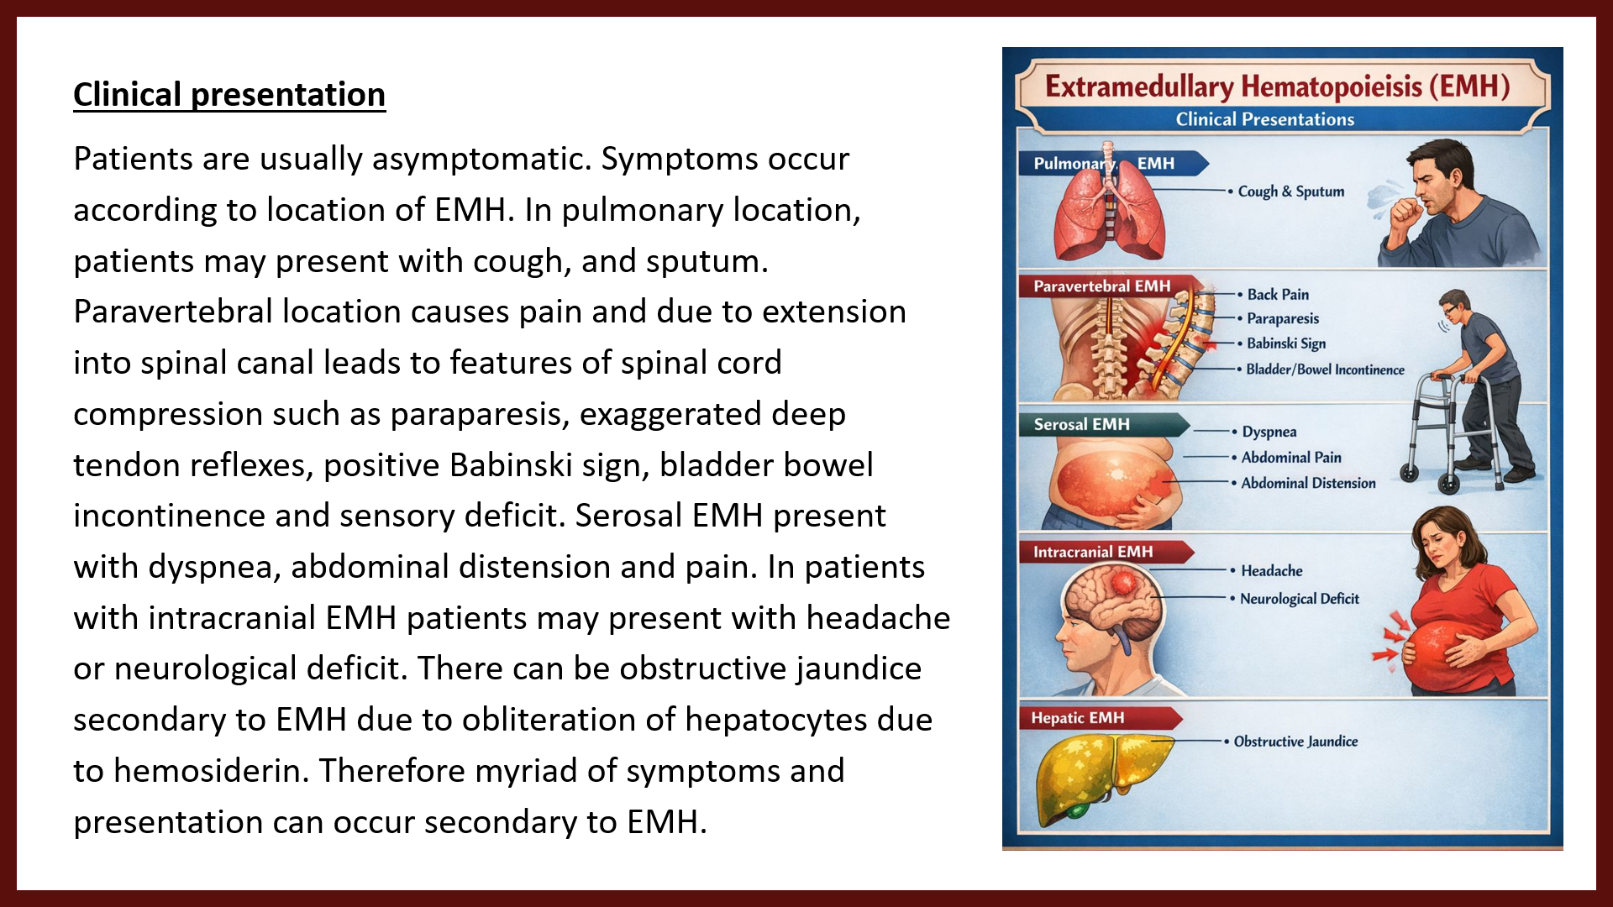
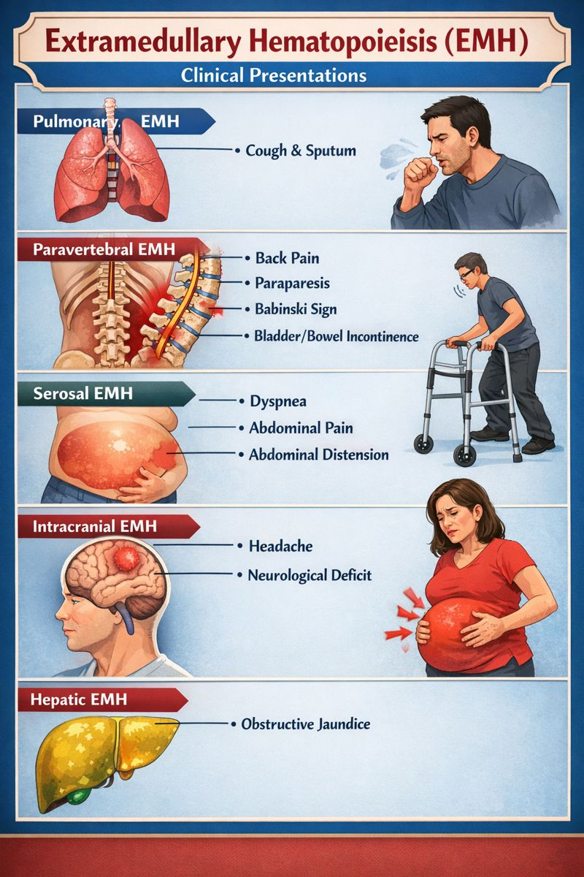
Clinical presentation
Patients are usually asymptomatic. Symptoms occur according to location of EMH. In pulmonary location, patients may present with cough, and sputum. Paravertebral location causes pain and due to extension into spinal canal leads to features of spinal cord compression such as paraparesis, exaggerated deep tendon reflexes, positive Babinski sign, bladder bowel incontinence and sensory deficit. Serosal EMH present with dyspnea, abdominal distension and pain. In patients with intracranial EMH patients may present with headache or neurological deficit. There can be obstructive jaundice secondary to EMH due to obliteration of hepatocytes due to hemosiderin. Therefore myriad of symptoms and presentation can occur secondary to EMH.

Slide 12
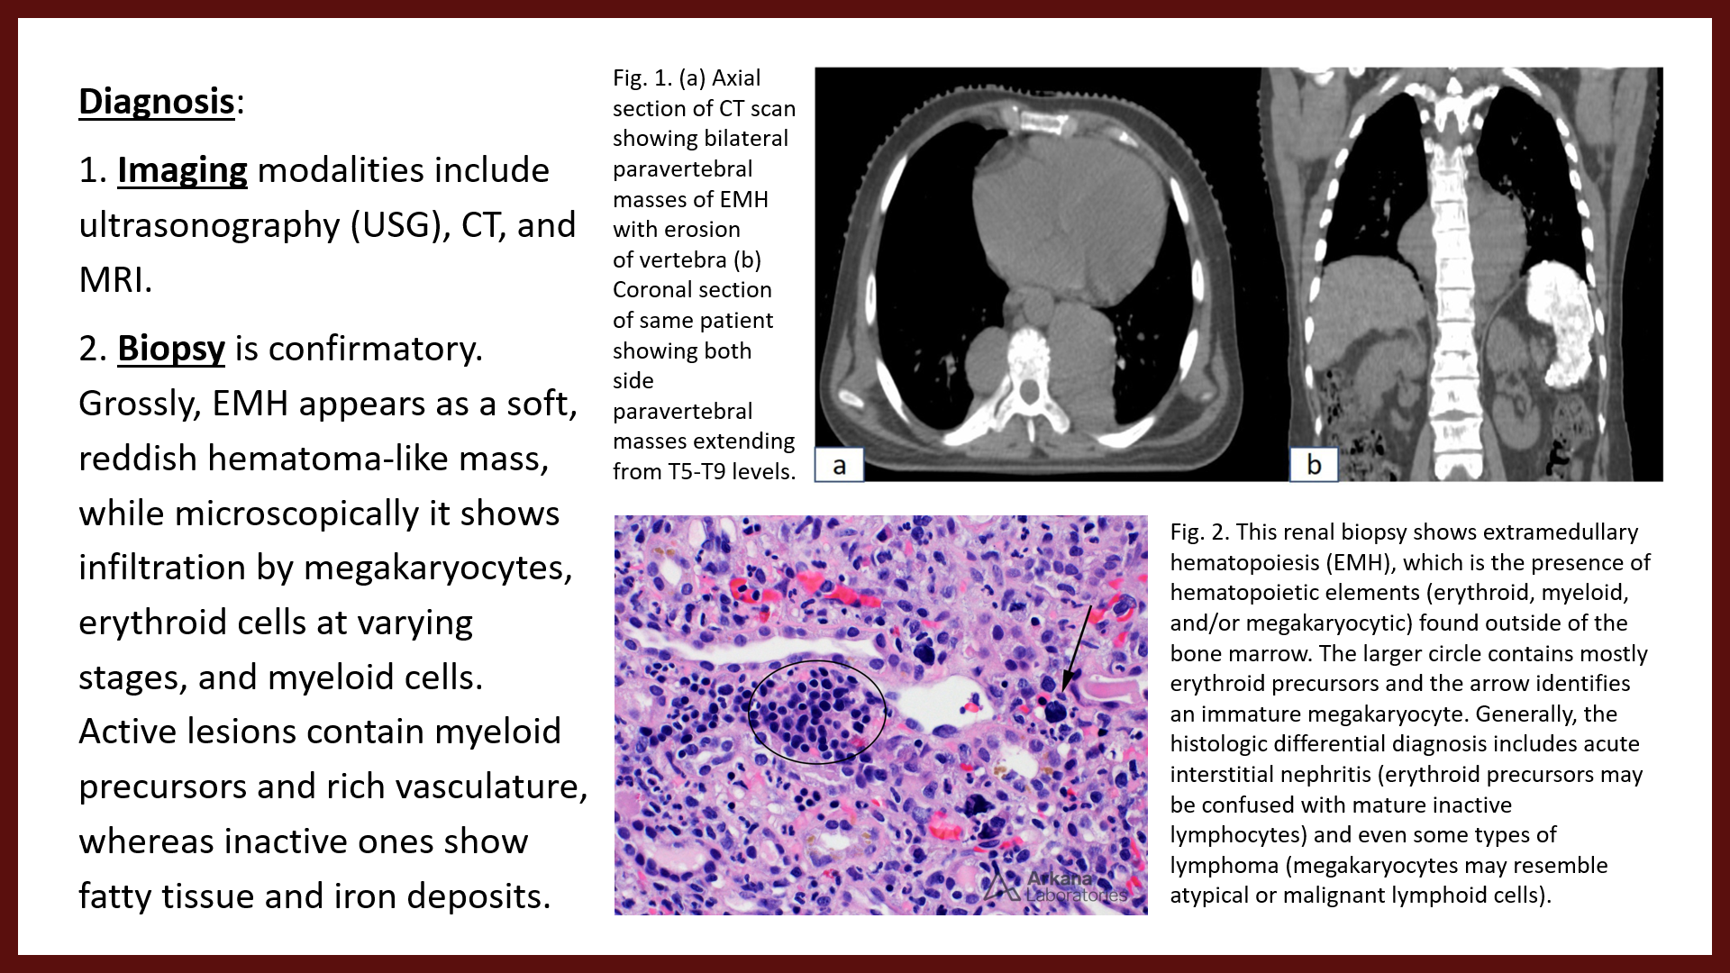
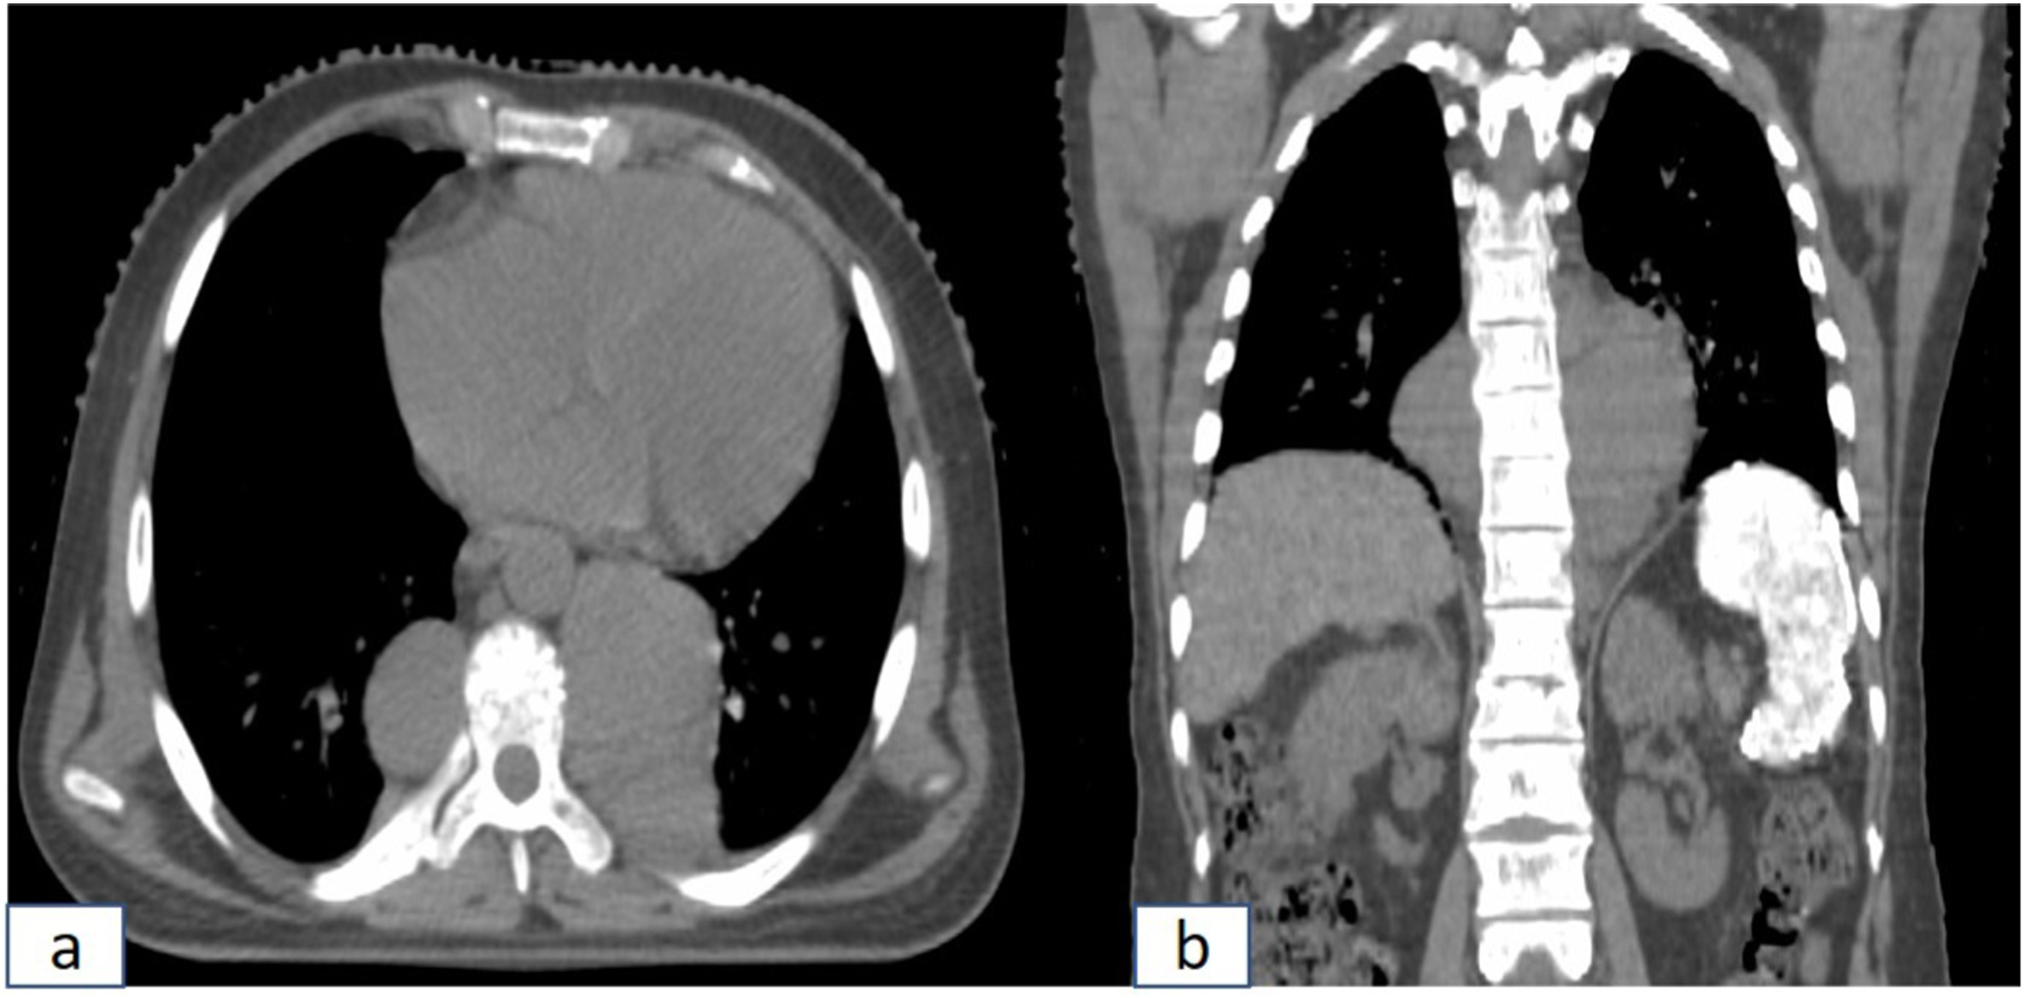
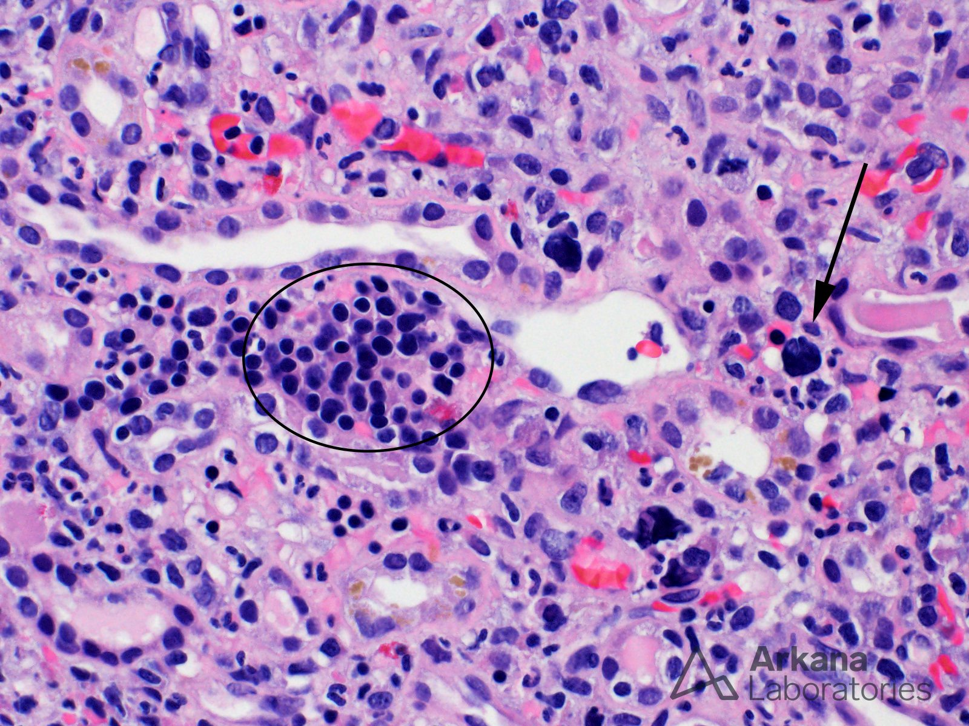
Diagnosis:
1. Imaging modalities include ultrasonography (USG), CT, and MRI.
2. Biopsy is confirmatory. Grossly, EMH appears as a soft, reddish hematoma-like mass, while microscopically it shows infiltration by megakaryocytes, erythroid cells at varying stages, and myeloid cells. Active lesions contain myeloid precursors and rich vasculature, whereas inactive ones show fatty tissue and iron deposits.
Fig. 1. (a) Axial section of CT scan showing bilateral paravertebral masses of EMH with erosion of vertebra (b) Coronal section of same patient showing both side paravertebral masses extending from T5-T9 levels.
Fig. 2. This renal biopsy shows extramedullary hematopoiesis (EMH), which is the presence of hematopoietic elements (erythroid, myeloid, and/or megakaryocytic) found outside of the bone marrow. The larger circle contains mostly erythroid precursors and the arrow identifies an immature megakaryocyte. Generally, the histologic differential diagnosis includes acute interstitial nephritis (erythroid precursors may be confused with mature inactive lymphocytes) and even some types of lymphoma (megakaryocytes may resemble atypical or malignant lymphoid cells).

Slide 13
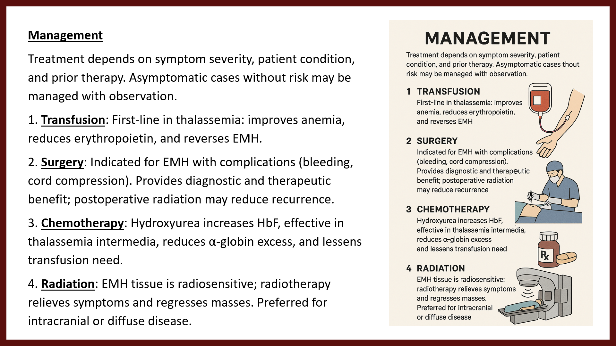
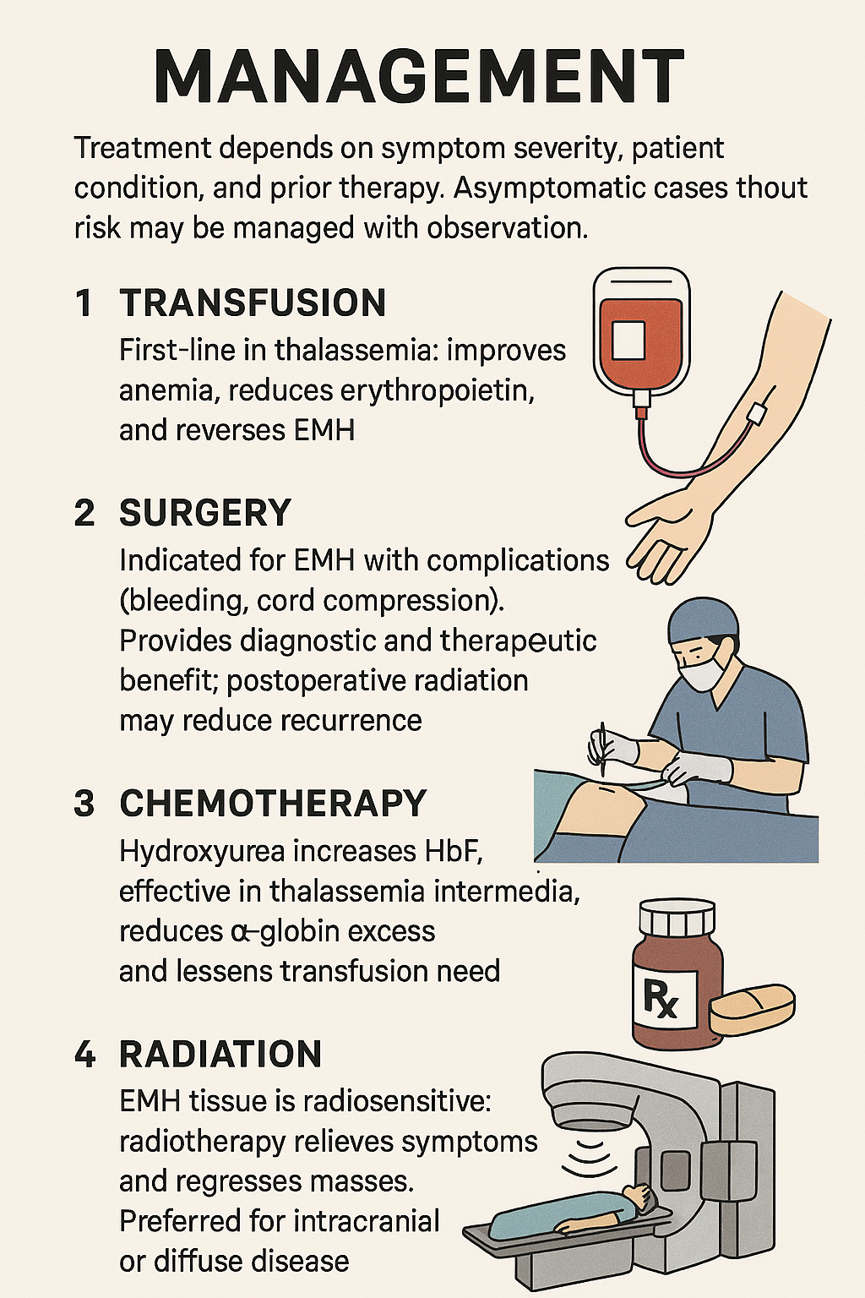
Management
Treatment depends on symptom severity, patient condition, and prior therapy. Asymptomatic cases without risk may be managed with observation.
1. Transfusion: First-line in thalassemia: improves anemia, reduces erythropoietin, and reverses EMH.
2. Surgery: Indicated for EMH with complications (bleeding, cord compression). Provides diagnostic and therapeutic benefit; postoperative radiation may reduce recurrence.
3. Chemotherapy: Hydroxyurea increases HbF, effective in thalassemia intermedia, reduces α-globin excess, and lessens transfusion need.
4. Radiation: EMH tissue is radiosensitive; radiotherapy relieves symptoms and regresses masses. Preferred for intracranial or diffuse disease.

Slide 14
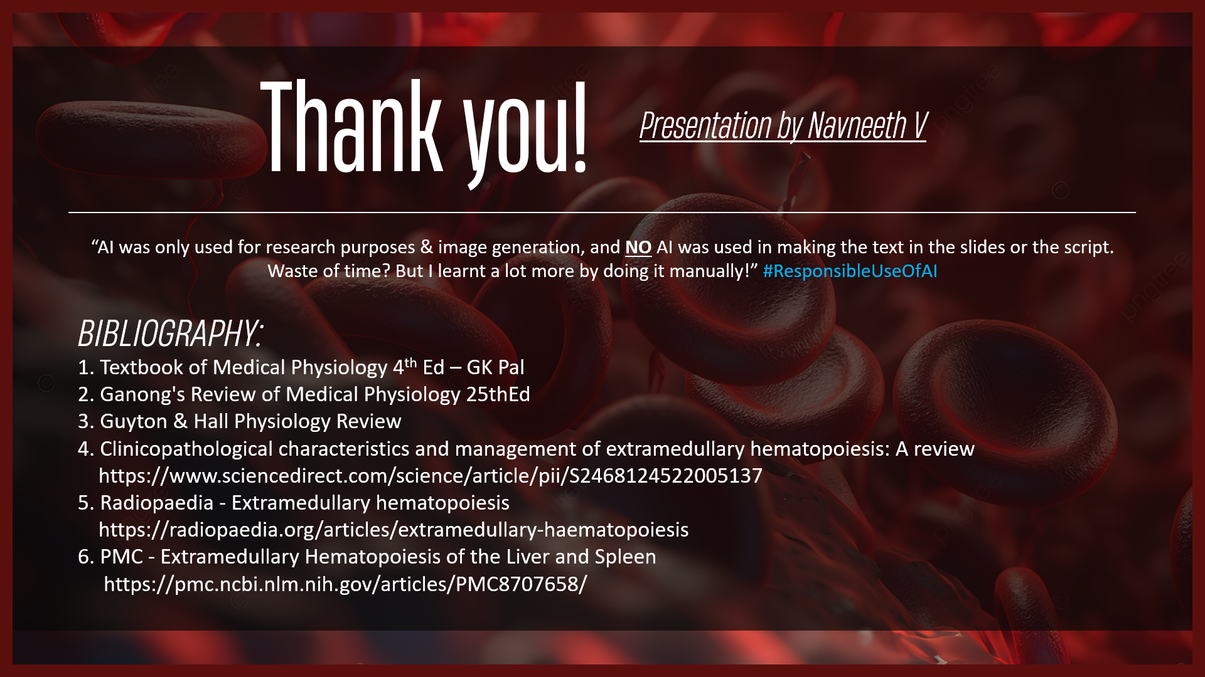
Thank you!
Presentation by Navneeth V
“AI was only used for research purposes & image generation, and NO AI was used in making the text in the slides or the script. Waste of time? But I learnt a lot more by doing it manually!” #ResponsibleUseOfAI
BIBLIOGRAPHY:
1. Textbook of Medical Physiology 4th Ed – GK Pal
2. Ganong's Review of Medical Physiology 25thEd
3. Guyton & Hall Physiology Review
4. Clinicopathological characteristics and management of extramedullary hematopoiesis: A review https://www.sciencedirect.com/science/article/pii/S2468124522005137
5. Radiopaedia - Extramedullary hematopoiesis
https://radiopaedia.org/articles/extramedullary-haematopoiesis
6. PMC - Extramedullary Hematopoiesis of the Liver and Spleen
https://pmc.ncbi.nlm.nih.gov/articles/PMC8707658/

